Slide 1
Chapter 3

Slide 2
Objectives

Slide 3
Objectives (continued)

Slide 4
The default Java code for an activity

Slide 5
How to work with an activity

Slide 6
The v7 appcompat support library

Slide 7
How to get references to widgets

Slide 8
An activity that gets references to the widgets

Slide 9
An activity that gets references to the widgets (continued)

Slide 10
How events work

Slide 11
How to handle the EditorAction event

Slide 12
An activity that handles the EditorAction event

Slide 13
An activity that handles the EditorAction event (continued)

Slide 14
A few constants from the EditorInfo class

Slide 15
Two methods for working with widgets

Slide 16
A method that calculates and displays amounts

Slide 17
How to handle the Click event

Slide 18
How to handle the Click event (continued)

Slide 19
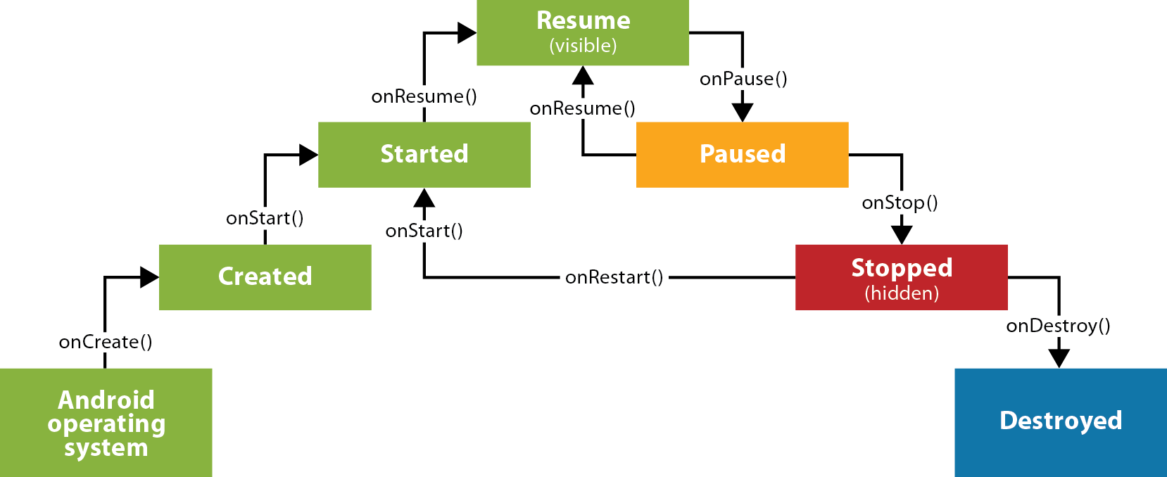
The lifecycle of an activity

Slide 20
Three common states

Slide 21
How to import the SharedPreferences classes

Slide 22
How to use onPause to save values

Slide 23
How to use onResume to restore values

Slide 24
The Java code

Slide 25
The Java code (continued)

Slide 26
The Java code (continued)

Slide 27
The Java code (continued)

Slide 28
The Java code (continued)

Slide 29
The Java code (continued)

Slide 30
The Java code (continued)

Slide 31
The Gradle build script

Slide 32
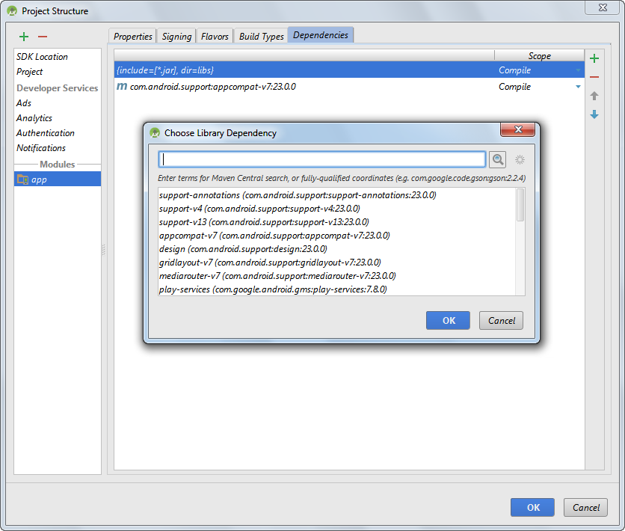
The dialogs for adding a dependency

Slide 33
A dependencies block

Slide 34
The AndroidManifest.xml file

Slide 35
An activity element that only allows portrait orientation

Slide 36
How to set the launcher icon for an app

Slide 37
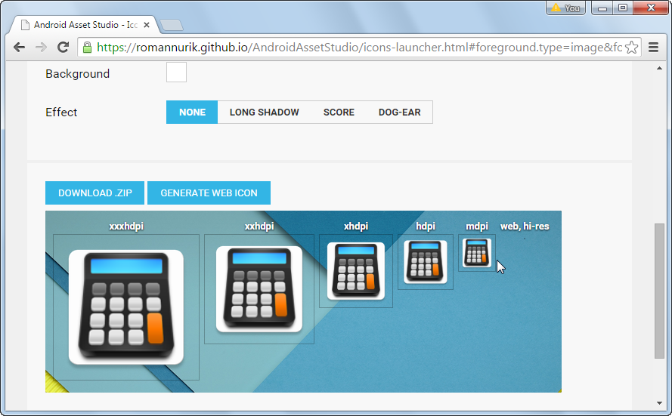
The Android Asset Studio web page for generating launcher icons

Slide 38
The directory structure for launcher icons

Slide 39
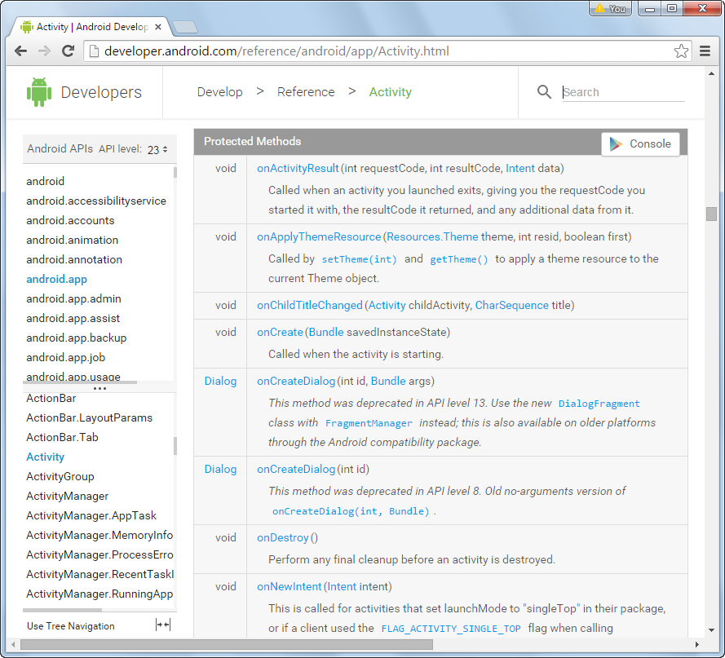
The documentation for the Activity class

